Slide 1

EPIRETINAL MEMBRANES IN PATIENTS WITH UVEITIS: MORPHOLOGICAL AND FUNCTIONAL ANALYSIS WITH SPECTRL-DOMAIN OPTICAL
L. Iannetti, P. Tortorella, R. Spena, R. Zito, A. Sapia, E. D’Ambrosio
“Sapienza” University of Rome
Department of Ophthalmology
Ocular Immunovirology Service
Hamburg 26-29 September 2013
13th Euretina Congress

Slide 2
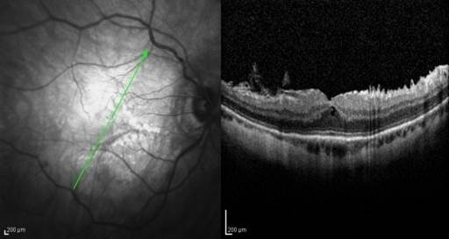
INTRODUCTION
Macular epiretinal membrane (ERM)
is a pathology caused by a fibrocellular proliferation
on the inner limiting membrane followed by cellular contraction
Contraction causes macular dysfunction
metamorphopsia
visual reduction
central unilateral diplopia

Slide 3
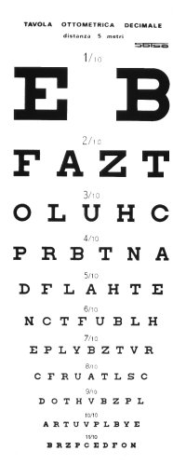
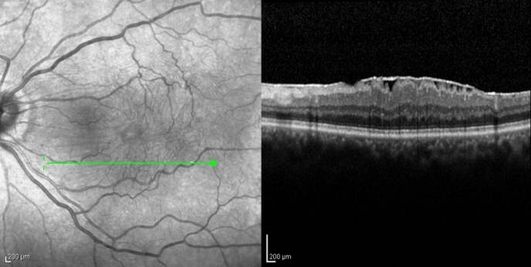
PURPOSE
To correlate the uveitic ERM features
observed by Spectral-Domain Optical Coherence Tomography (SD-OCT)
with visual acuity (BCVA)

Slide 4
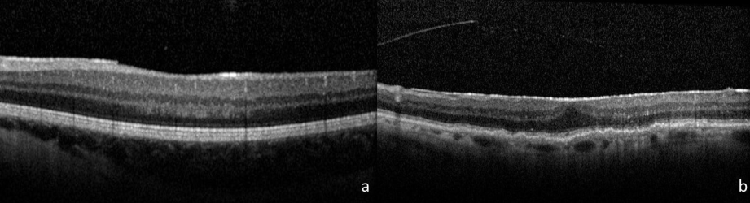
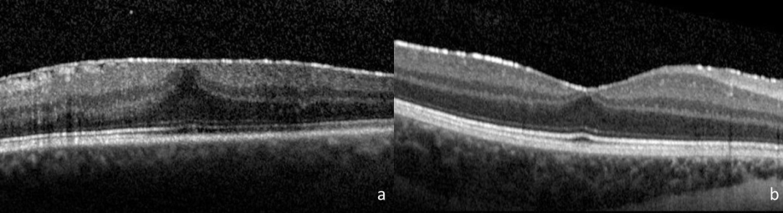
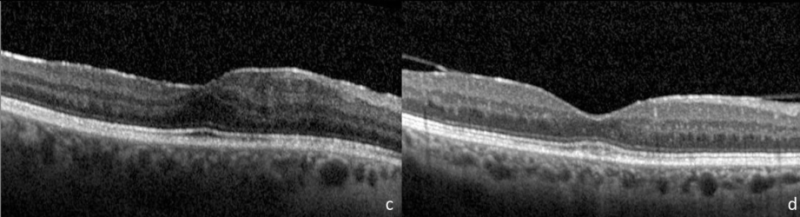
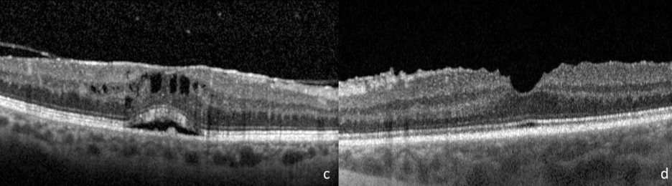
METHODS
METHODS:
41 eyes of 32 patients
Retrospective study
SD- OCT
BCVA
ERM THICKNESS
First time
Diagnosis
Second time
Final visit
Morphological and clinical features
Fig. 1
a. focal pattern of ERM attachment , b. broad pattern of ERM attachment, c.foveal involvement of ERM, d. no foveal involvement of ERM.
Fig. 2
loss of foveal concavity, b. precence of foveal concavity, c. presence
of cystoid macular edema, d. absence of cystoid macular edema.

Slide 5
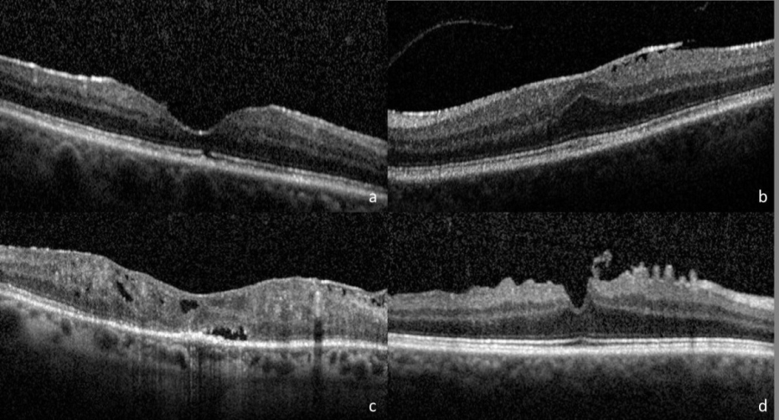
RESULTS
RESULTS
positively correlated with:
male sex (p<0.01) and focal
pattern of ERM attachment (p<0.05)
BCVA
negatively correlated with:
with IS/OS
photoreceptor junction distruption (p<0.05)
positively correlation with:
the age of ERM onset (p<0.1)
BCVA
CHANGE
negatively correlation with:
IS/OS photoreceptor distruption at the ERM diagnosis (p<0.05)
increase of central subfield thickness (p<0.1)
Fig. 3
a. disruption of IS/OS photoreceptor junction,
b. integrity of IS/OS photoreceptor junction,
c. disruption of ELM,
d. integrity of ELM.

Slide 6
CONCLUSIONS
RESULTS
During the follow-up ERM thickness correlated with:
male sex (p <0.05)
posterior uveitis (p<0.05)
uveitis duration (p<0.05)
broad attachment pattern (p<0.1)
Final ERM thickness correlated with:
duration of uveitis (p<0.01)
duration of ERM (p<0.001)
FINANCIAL DISCLOSURE:
This research received no specific grant from any funding agency in the public, commercial or not-for-profit sectors.

